Slide 1
Multimodal Learning for Visual Question Answering
Final Project
Ziyu Zhao

Slide 2
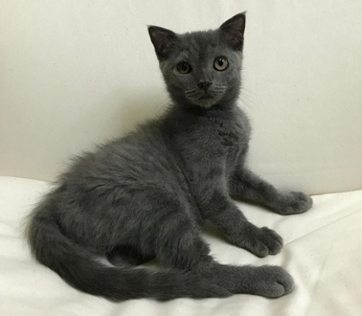
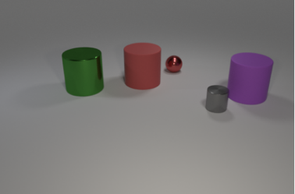
Motivation
Current artificial neural networks are very good at pattern recognition but not so good at reasoning.
R-CNN
cat
Object recognition
Object detection
Notes:
I am going to start by stating the motivation for my topic.
Current deep learning models are very good at pattern recognition.
For example, image recognition and object detection
Given this image, the model can classify that this is a cat with high accuracy.
Similarly, deep learning model, such as R-CNN can also detect object with high accuracy.
But, they are still not very good in tasks that requires high level reasoning skills or tasks that require multi-step inferrence.
for example counting, understanding the relationship between objects or making comparision between objects
So this is the topic that I am very interested in.
researching how to improve the reasoning capabilities of ANNs.

Slide 3
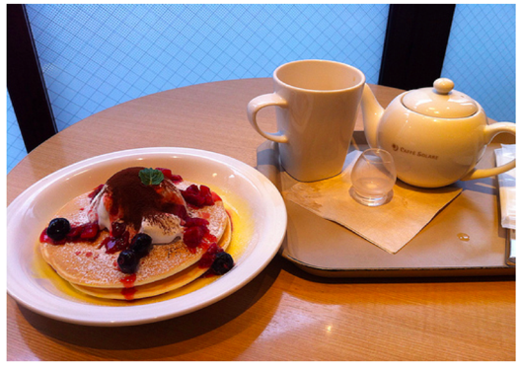
Overview
Visual Question Answering (VQA)
What color are her eyes?
What is the mustache made of?
Visual Reasoning
Is there any fruit to the left of the tray the cup is on top of?
Are the napkin and the cup the same color?
Computer Vision
Natural Language Processing
Reasoning
VQA/ visual reasoning
Notes:
First of all, I’m going to state the overview of this project. So, I chose to study about how to improve the reasoning capabilities of deep learning model in the context of visual question answering (VQA) and visual reasoning.
Visual Question Answering (VQA) is an emerging research problem at the intersection of computer vision, natural language processing and knowledge reasoning.
This is challenging because
A VQA task is usually framed as a classification problem.
Where the list of all possible answers in the dataset are taken as the targets for supervised training.
For this project, on the other hand, the task that I am focusing on is the visual reasoning.
It can be considered to be sub-task of VQA, but with more emphasis on evaluating the reasoning capabilities of deep learning models.
Object and attribute recognition
Transitive relation tracking
Spatial reasoning
Logical inference
Counting
Making comparisons

Slide 4
Aims and Objectives
Objectives
Study existing deep learning models for VQA and visual reasoning
Explore recent approaches which extend the reasoning capabilities of artificial neural networks
Test on my created mini-dataset.
Aim
Extending a new VQA model based on Transformer architecture
Utilising self-attention and co-attention mechanism
Notes:
The initial objectives of this project is to study existing deep learning models for VQA and visual reasoning
As well as to explore recent approaches which extend the reasoning capabilities of artificial neural networks
Such as attention mechanism
After initial researches, I found the Transformer architecture to be the most promising.
As recently, deep learning models based on Transformer (e.g. BERT and GPT) have achieved positive results in various NLP tasks, including question answering, machine translation and text generation,
Given this, the main aim of this project is to develop a new VQA model based on Transformer architecture.

Slide 5
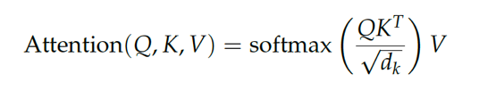
Background - Transformer
Self-attention
Notes:
Before I talk about the model I developed for a VQA task, let me give the background of the Transformer architecture.
Transformer is designed for sequence processing task.
But unlike an RNN, it is entirely built on self-attention mechanism to draw global dependencies between input and output
self-attention is an attention mechanism relating different positions of a single sequence in order to compute a representation of the same sequence
Self-attention in transformer relies on the scaled dot-product attention to compute the attention score between each word and every other word.
First, the input sequences are projected into three matrices: Query. (Q), Key (K), and Value (V),
Then dot product between query and key (QKT) is performed to discover the attention score between each input element and all other elements.
The attention scores are divided by the square root value of the key dimension to stabilize gradients during training.
Then the softmax function is applied to the scaled attention score to ensures that the weights are sum to 1.
Finally, the outputs are represented as the weighted sum of the value vector (V).
Rather than only computing the attention once, Transformer performs scaled dot-product attention multiple times in parallel.
This is called multi-head attention.
So this allows the model to jointly attend to information from different representation subspaces at different positions”
This was basically the main component of the Transformer architecture, and what makes them work so well in sequence processing task.

Slide 6
Model Details
Multimodal Transformer
CNN
Notes:
Now, I am going to talk about the details of the model that I developed.
The architecture of the model consists of three main components
input feature extractors
a stack of multimodal Transformer layer (Nx)
multimodal fusion layer and a classifier
The input feature extractors (CNN, LSTM) and the classifier components are similar to most existing VQA models.
The main difference between other models is how I stack these two transformer module together, and the use of special tokens, the [IMG] and [TXT] tokens
To extract the image features, I used the pre-trained ResNet architecture.
And to extract the question feature, I used GloVe word embedding and bidirectional LSTM.
As shown here, I also inserted the [IMG] and [TXT] tokens at the beginning of each sequence.
These are added to extracted the information related to answer from both visual and textual input in the Transformer layer.
The multimodal Transformer encoder block consists of two components: standard Transformer layer (TRM) and Co-attention Transformer layer
These two layers are based on multi-head attention concept. However, in Co-TRM layers, the keys and values from each modality are swapped
As we can see here, the output of [IMG] and [TXT] tokens from the final layer of multimodal Transformer are used as the pooled representation of image and question.
They are fused by element-wise products and are sent through the classifier layer to obtain the answer.

Slide 7
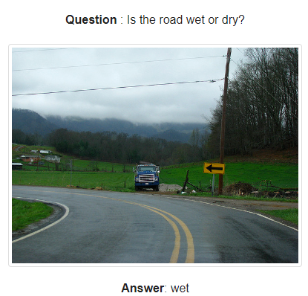
Datasets
CLEVR
850K automatically generated questions
My dataset
100k synthetic images of 3D-rendered objects
Notes:
In this project, I used two visual reasoning datasets,
The first one is the CLEVR dataset
It contains 850K generated questions
With 100K synthetic images
3 shapes (cube, cylinder, and sphere)
2 materials (shiny “metal” and matte “rubber”)
2 sizes (small and large)
8 colours
The second dataset is created by my own. So I just downloaded 40 images from website which are all about transportation and gave one or two questions for each image with answers.
These are designed to test various high level reasoning, such as spatial reasoning, counting, and making comparision.
As shown here, the question are highly compositional and requires multi-step inferences.

Slide 8
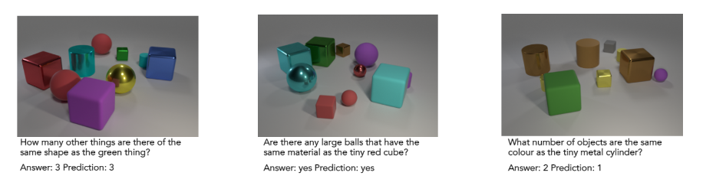
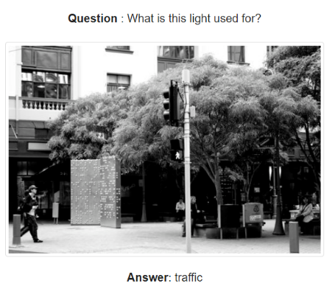
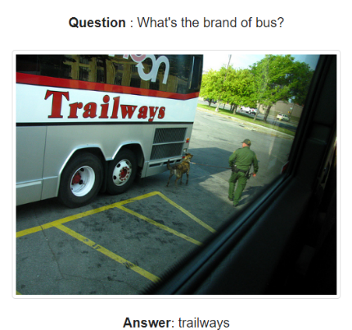
Results
 | CLEVER | Our dataset
Accuracy | 95.6 | 83.3
Prediction: wet
Prediction: traffic
Prediction: trailway

Slide 9
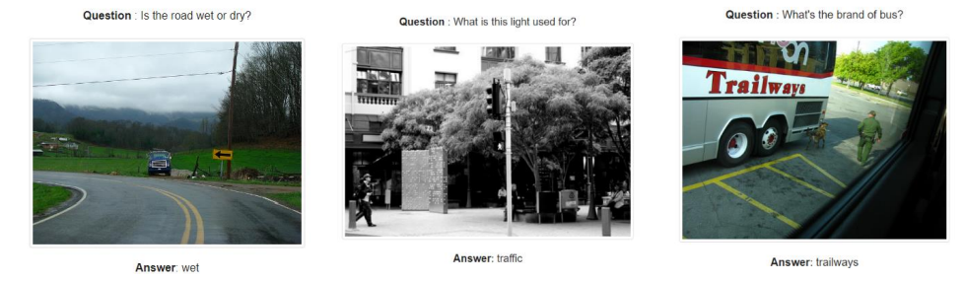
Project Name: Multimodal Learning for Visual Question Answering
Problem: Current artificial neural networks are very good at pattern recognition but not so good at reasoning.
Approach: Extending a new VQA model based on Transformer architecture
Utilising self-attention and co-attention mechanism
Result:
 | CLEVER | Our dataset
Accuracy | 95.6 (overall) | 83.3
CLEVER:
Multimodal Transformer
CNN
My dataset: (inspired on the OK-VQA dataset)
input feature extractors (CNN, LSTM)
a stack of multimodal Transformer layer (Nx) (standard Transformer layer (TRM) and Co-attention Transformer layer)
multimodal fusion layer and a classifier

